Slide 1
Movie Lens Recommendation system
By: Thomas Cornett
Notes:
Thank you for joining us today my name is Thomas. I have been tasked by Inspire movie company to make a recommendation system to give their users movies that they might like based off other movies they have seen.

Slide 2
Overview
Netflix
Amazon
Hulu
News articles
Notes:
Recommendation systems are used all over the place, even area’s that you would never think about. What a recommendation system does is exactly what it sounds like, and a perfect example is Amazon or Netflix.
Amazon keeps track of everything that is viewed on your account and tries to recommend relevant or closely related items that you have viewed.
Netflix or Hulu on the other hand will try to show you movies and tv shows they think you will like based off things that you have previously watched. It sounds like the same thing but it’s a bit different, when it comes to movies and tv shows there is about 26 main categories that a single movie will be categorized as well as subcategorized as. And that is what I will be attempting to do here, recommend movies based off user ratings from the Movie Lens data.

Slide 3
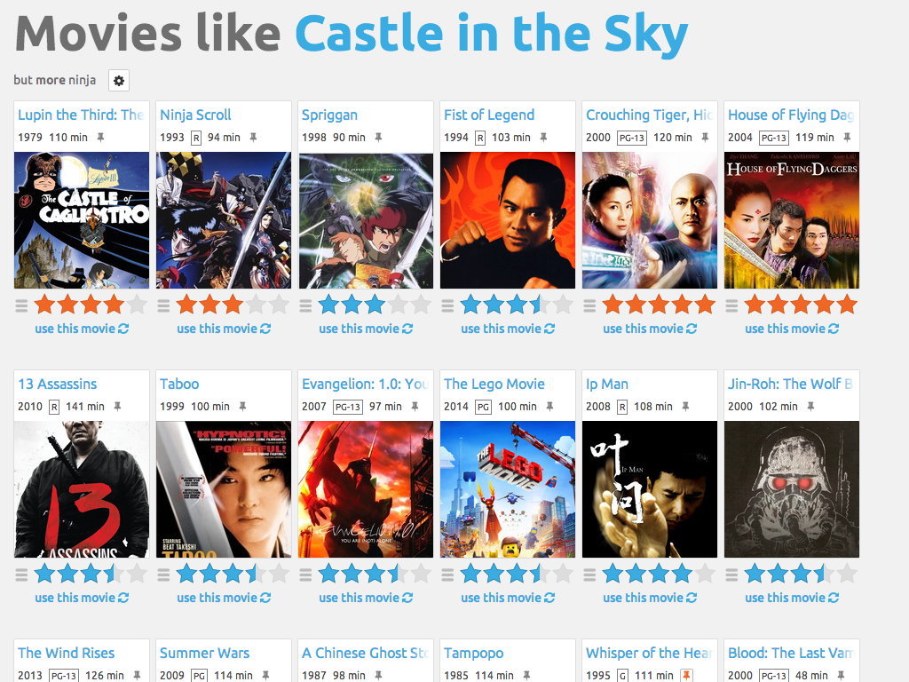
What is Movie Lens?
Notes:
MovieLens is a web-based recommender system and virtual community that recommends movies for its users to watch, based on their film preferences using collective filtering of members' movie ratings and movie reviews. It contains about 11 million ratings for about 8500 movies. MovieLens was created in 1997 by GroupLens Research, a research lab in the Department of Computer Science and Engineering at the University of Minnesota in order to gather research data on personalized recommendations.

Slide 4

Recommendation systems limitations
Cold start issue
Changing user preferences
Changing data
Notes:
Recommendation systems are not a one stop shop by any means. They are limited in a few ways, one of the biggest limitation is what has been dubbed as the cold start problem. The cold start problem or issue is when you get a new user signed up there is no history or data to give them a recommendation(s) about what movies to watch or see. Another big problem is the user preferences are always changing. One month I might want to binge action movies and the next I want to watch romance or fantasy movies. And finally, as always there is always new movies that come out that change the data, so it is always needing to be updated.

Slide 5
Project Overview
I created a movie recommender that is based on the genre that the user likes. it takes in the user's movie ratings and gives 5 recommendations of other movies they might like based off others users that have similar tastes.
The data that I have trained my model on is a rich dataset of over 100,000 ratings on 1,700 movies with 1,000 users.

Slide 6
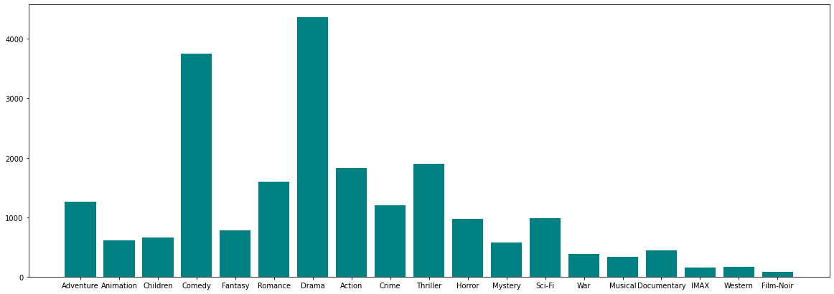
Genres
Notes:
This is the distribution of the Genres of the dataset. As you can see there is a lot of drama and comedy videos.

Slide 7
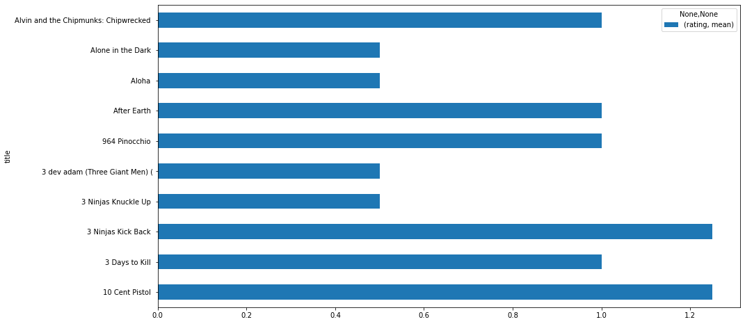
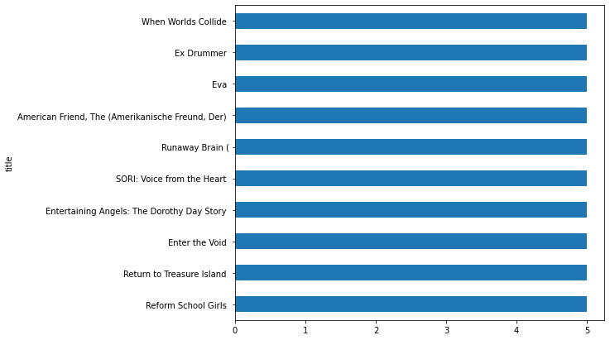
Rated movies
Lowest rated movies
Highest rated movies
Notes:
Here we have the lowest and highest rated movies.

Slide 8




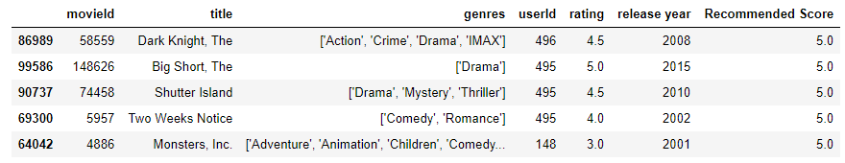
Peer to peer
Notes:
Peer to peer is a recommendation approach where the user compared across the board with other users and tries to find another user that has scored some of the same movies close to theirs. When the system finds someone that has rated almost the same as the you it takes their ratings into account and then recommends movies based off what the other user has rated. This user with userId of 96 (not seen) scored close to the user 496 so the system recommends these top 5 movies to user 96

Slide 9
Future work
Gathering more relevant data.
Using the dates of the ratings to determine more relevant recommendations based off newer movies unless specified that you like older movies
Graphical User Interface implemented with pictures.

Slide 10
Thank you!
Notes:
Thank you for taking the time to come out.

Slide 11
Any Questions?

